Slide 1




AIR QUALITY MONITORING
By
R.GNANAMOORTHI
Notes:
To view this presentation, first, turn up your volume and second, launch the self-running slide show.

Slide 2

PROJECT DEFINITION
The Air Quality Management Enhancement Project is aimed at improving and maintaining the air quality in a specific region or community.
This project seeks to identify, address, and mitigate the various factors contributing to air pollution and to develop sustainable strategies for long-term air quality improvement.
Notes:
To view this presentation, first, turn up your volume and second, launch the self-running slide show.

Slide 3
Project Objectives
To assess the current air quality in the target area, identifying key pollutants and their sources.
To develop a comprehensive air quality management plan, including strategies for pollution reduction and prevention.
To establish clear air quality standards and to enhance public awareness and engagement in air quality issues.
To monitor and evaluate the effectiveness of implemented measures and make necessary adjustments.
Notes:
To view this presentation, first, turn up your volume and second, launch the self-running slide show.

Slide 4
IOT DEVICES DESIGNS
AEROQUAL SERIES 200/300
The Aeroqual Series 200 and 300 are portable and handheld air quality monitors known for their accuracy and versatility.
They can measure various air pollutants, including ozone (O3), nitrogen dioxide (NO2), sulfur dioxide (SO2), carbon monoxide (CO), and particulate matter (PM2.5 and PM10).
These sensors are widely used for environmental monitoring, industrial applications, and research.
Notes:
To view this presentation, first, turn up your volume and second, launch the self-running slide show.

Slide 5
ESP8266 MICROCONTROLLER :
These Wi-Fi and Bluetooth-enabled microcontrollers from ESP8266 are popular for IOT projects, including air quality monitoring. They are energy-efficient and offer built-in Wi-Fi connectivity, making it easy to transmit data to the cloud or a local server.
Pros: Low power consumption, wireless connectivity, extensive libraries, and community support.
Cons: Limited GPIO pins on the ESP8266.
Notes:
To view this presentation, first, turn up your volume and second, launch the self-running slide show.

Slide 6
Data Sharing Platform
Cloud Storage and File Sharing Platforms:
Use Case:
These platforms primarily focus on storing and sharing files and documents. They are suitable for individuals, businesses, and organizations looking for a simple way to collaborate on documents and share files securely.
Examples:
Google Drive, Microsoft OneDrive, Dropbox
Notes:
To view this presentation, first, turn up your volume and second, launch the self-running slide show.

Slide 7
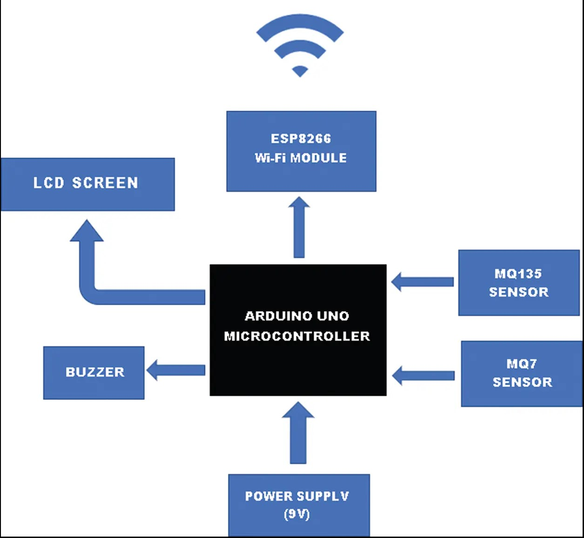
Integration Approach
Notes:
To view this presentation, first, turn up your volume and second, launch the self-running slide show.

